Slide 1
Globally-Optimal Greedy Algorithms for Tracking Variable Number of Objects
C.V. Project: Fourier and Duals
Mohsin Mustafa, Ramkishore Saravanan and Shyamgopal Karthik

Slide 2
Brief description of the paper
Find the objects in each frame.
Formulate observations of transitions, start and terminations of tracks as a Markov Model. Use MAP to maximize observed probabilities.
Formulate ILP to select optimal tracks from MM.
Convert ILP to DAG, with edge weights as negative of transition probabilities.
Solve ILP by finding shortest paths, paths with highest probabilities.

Slide 3
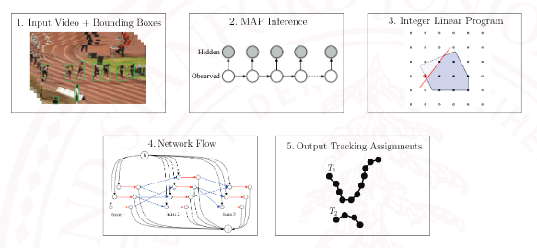
Algorithm Pipeline

Slide 4
Mathematical Representation

Slide 5
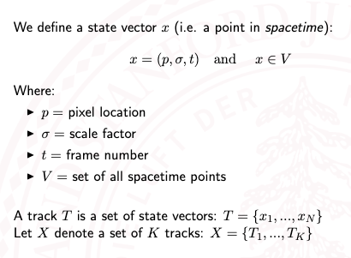
Notation

Slide 6
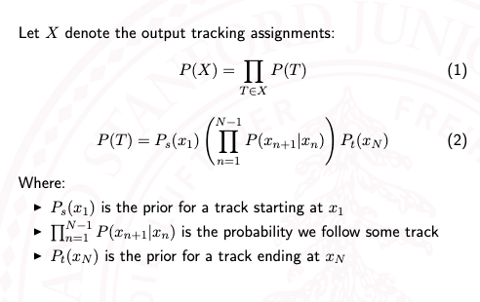
Markov Model

Slide 7
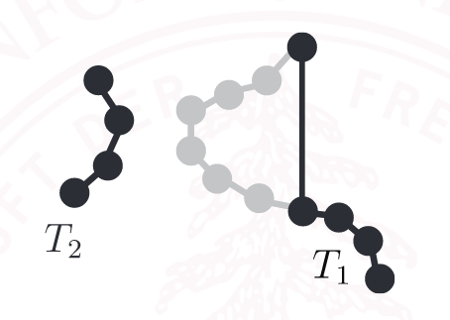
Modelling Occlusion
Tracks can be made of non consecutive frames.
An upper limit is set on the number of frames that can be skipped to deal with time complexity.

Slide 8
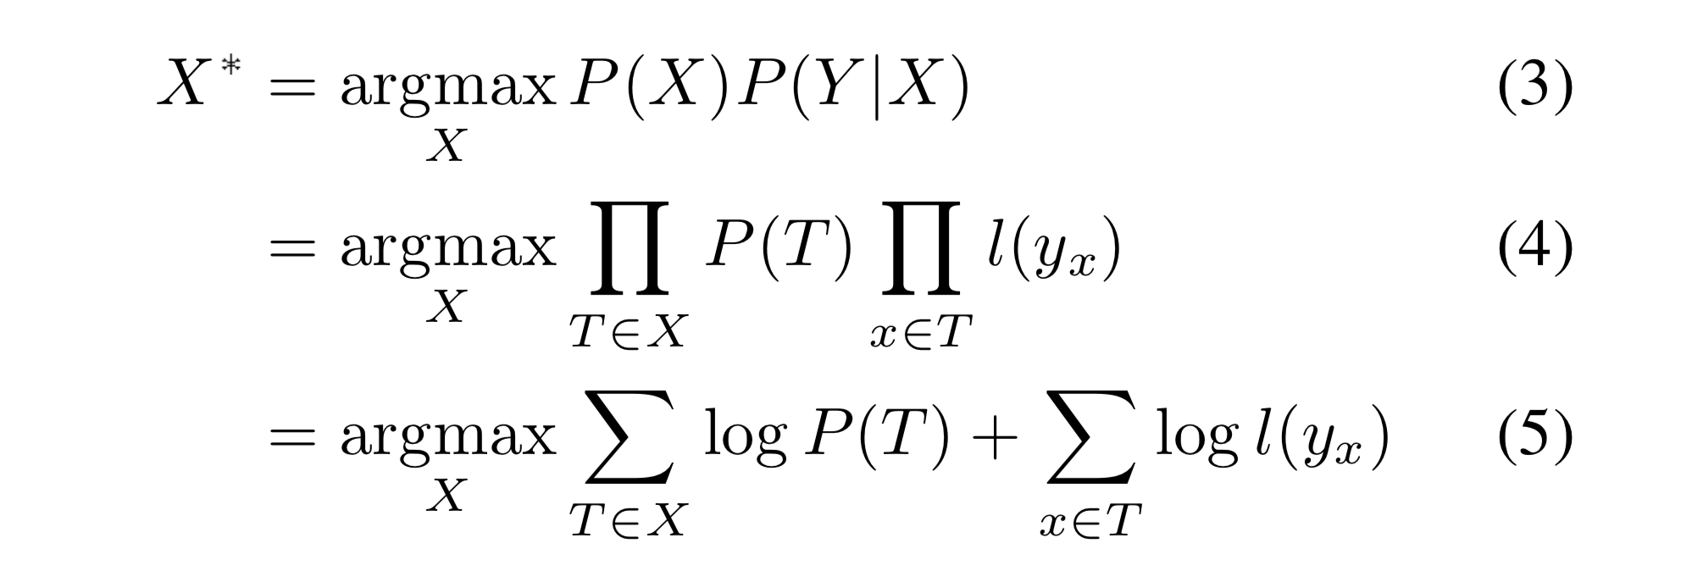
MAP inference

Slide 9
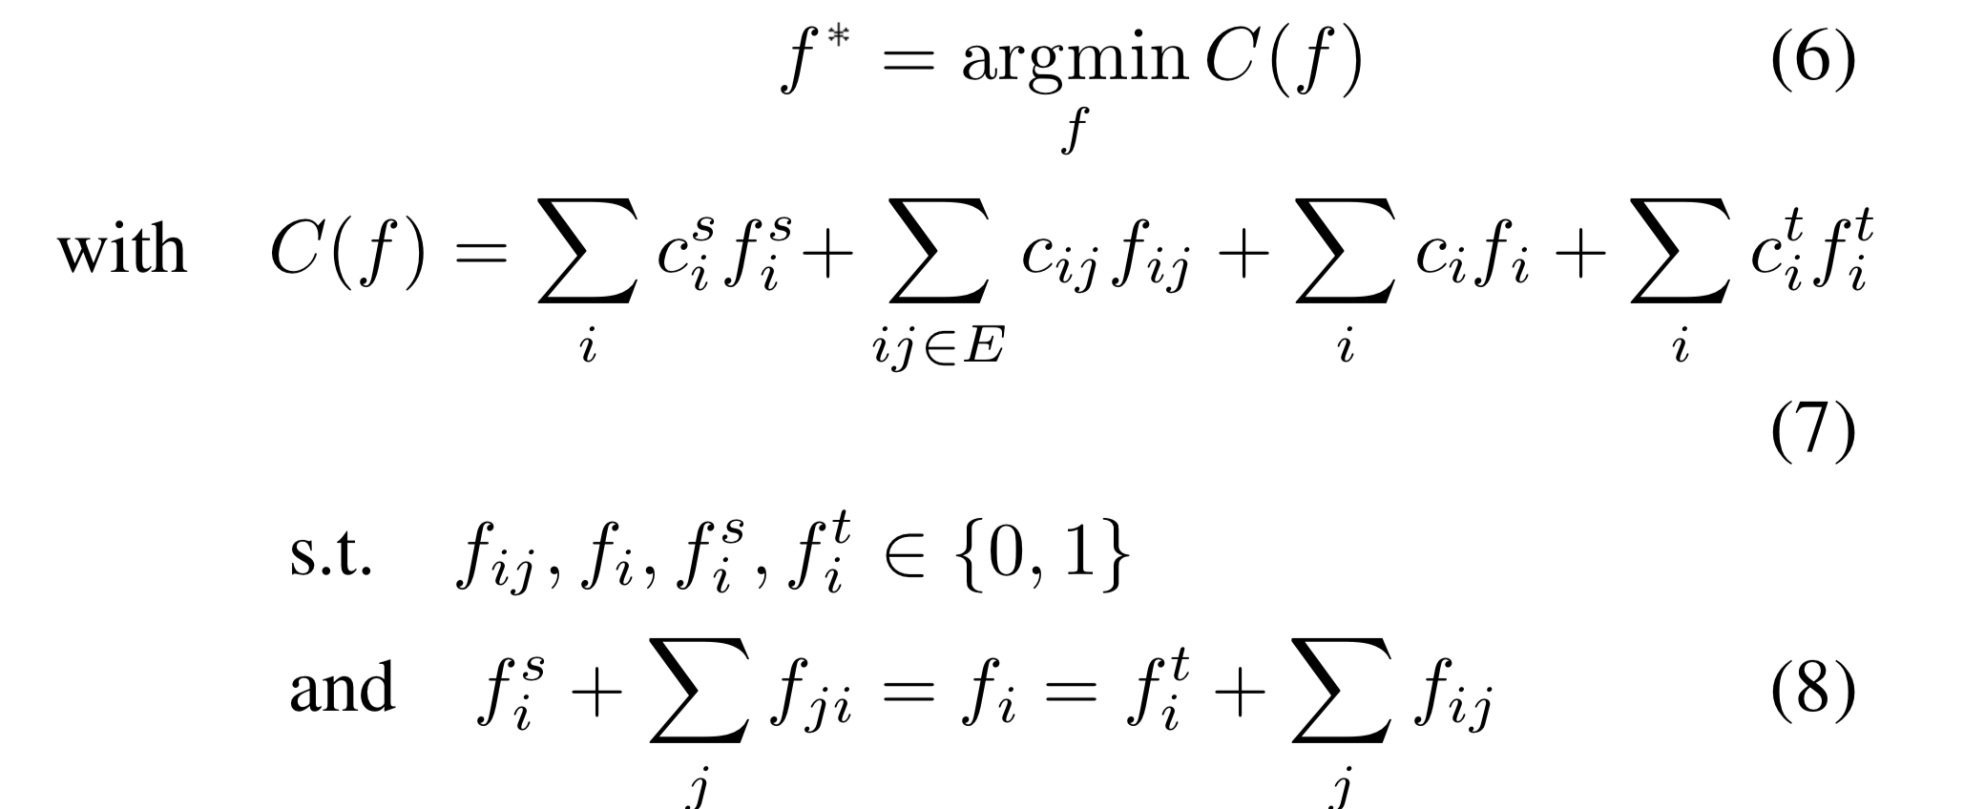
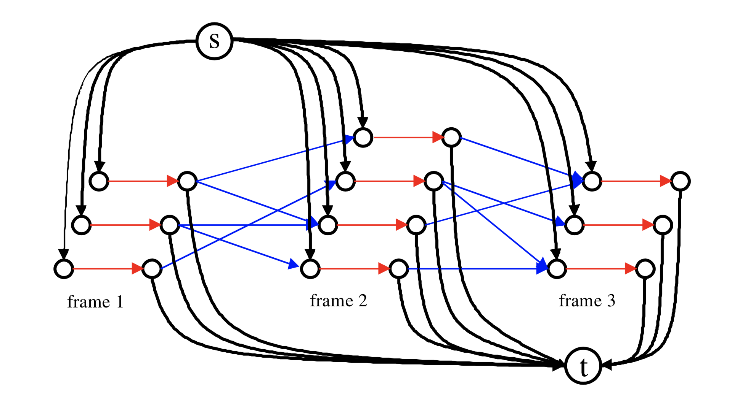
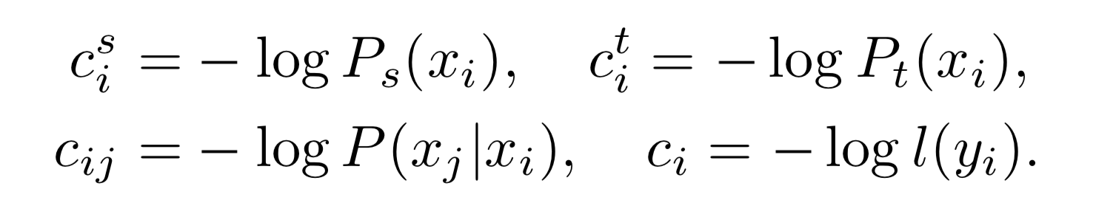
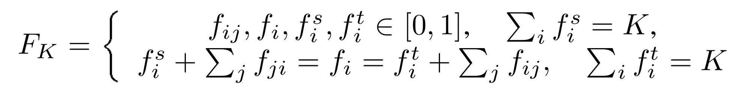
MAP to ILP

Slide 10
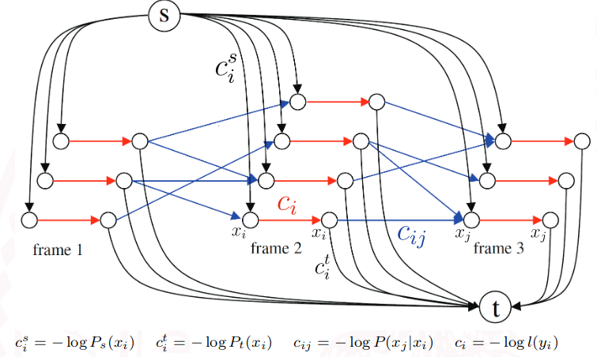
ILP to network flow
Create a pair of vertices for every detection in a frame.
Add an edge from the source to the first vertex
Add an edge from the second vertex to the sink.
Add an edge between the 2 vertices which represents the cost of using that detection in the track
Add edges to vertices of future frames to model the transitions between frames
All edges have unit weight, but a certain cost to pick the edge
Sending a flow of "K" from the source to sink on this graph corresponds to having "K" tracks. And picking the flow with minimum cost corresponds to a globally optimal solution.
Effectively, the problem has now been reduced to a min cost flow problem.
Since the graph has edges of unit capacity and is a DAG, we can solve this problem efficiently.

Slide 11
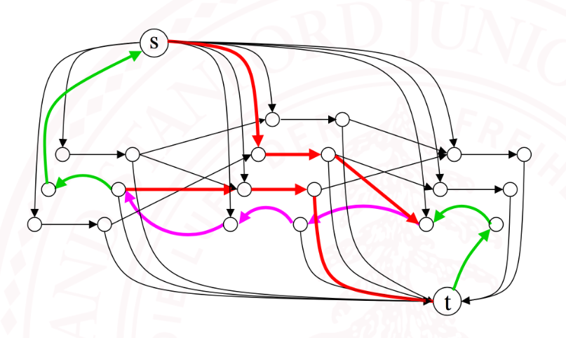
Solving using Successive Shortest Paths
Find minimum cost from s to t in the residual graph
If the cost of this path is negative, update the residual graph by pushing a unit flow along this path.
This algorithm can be done in O(KNlogN) using Dijkstra's algorithm for finding the shortest paths.
However, we can come up with a simpler solution for this Problem!

Slide 12
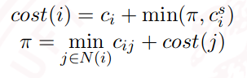
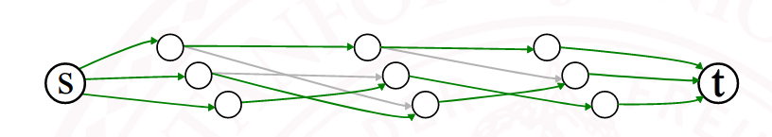
Solving for K=1 using Dynamic Programming

Slide 13
Results for Tracking with DP for K =1
(from our experiments)

Slide 14
Approximate Solution for K>1
Use the previous dynamic programming algorithm to compute the shortest path
Remove the edges of the path and repeat
Stop when the overall cost increases

Slide 15
Approximate solution for K > 1
(from our experiments)

Slide 16
Experimental Details
Caltech Pedestrian Dataset: 71 videos with 1800 frames at 30 fps.
ETHMS Dataset: 4 videos 1000 frames at 14fps
Generate the bounding boxes(vertices of the graph) using HOG based pedestrian detector from OpenCV
Evaluation Metrics: Detection Rate (Number of Correct ID Labelings/Total no. of ID Labelings) and False Positives Per Frame(Total No. of False Positives/No. Of Frames)

Slide 17
Further Scope
Implement "Joint Tracking and Segmentation (CVPR 2015)" if time permits.
The key addition in this new work is to use superpixel level information in addition to the bounding boxes. Instead of formulating an ILP, a Conditional Random Field (CRF) is used and is solved using the alpha-expansion algorithm.

